Slide 1
Twitter US Airline Sentiment Analysis
By William Dew

Slide 2
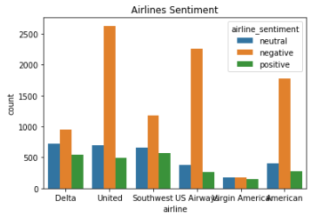
Data

Slide 3
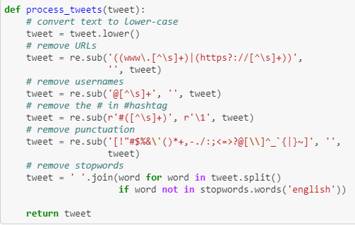
Data Wrangling

Slide 4
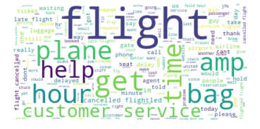
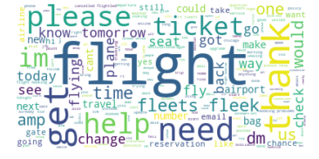
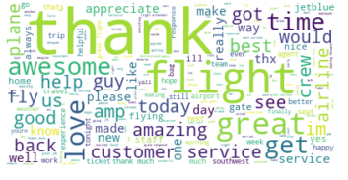
Word balloons
Negative
Neutral
Positive

Slide 5
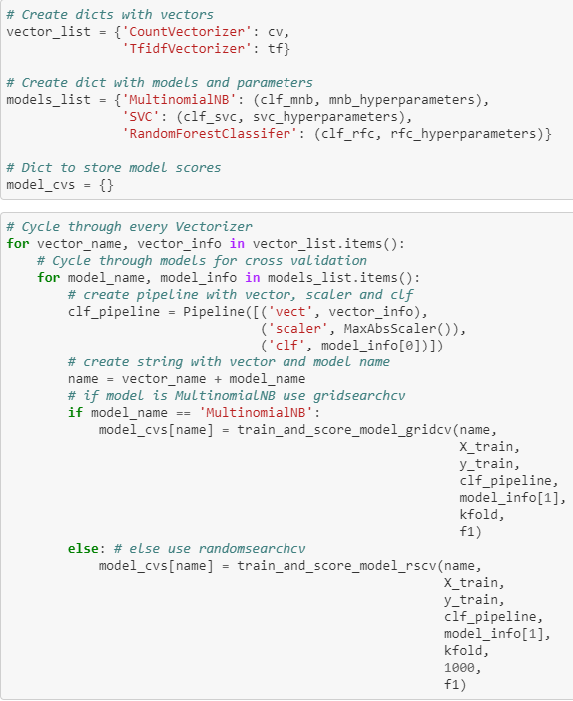
models
Vectorizers
CountVectorizer
TfidfVectorizer
Classifiers
MultinomialNB
SVC
Random Forest
Cross Validation
Grid Search CV
Random Search CV

Slide 6
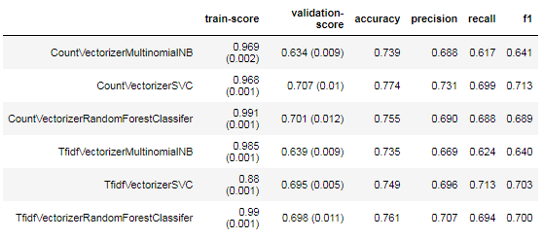
results
F1 score for Train-score and Validation Score from Cross Validation of Train Set
Metric Scores for Test Set with Best Estimator Found

